Slide 1
Battle of the Neighborhoods
Data Science capstone project

Slide 2
Business Problem
The scope of this project is to find the most suitable location for opening a new Cafe Equipment Cleaning & Maintenance company in Toronto North York. Key factors will be the number of cafes in the targeted area and the possibility of combining office location with place of residence.
Key Factors
An office location with many potential customers close by will raise revenue and minimize operational & marketing costs
It will be beneficial for the company owner to live close by to his office, as long as one of two important personal parameters are met
The place of residence should be near parks
There should be a variety of restaurants close by
Target Audience
Any individual who wishes to open a Cafe Equipment Cleaning & Maintenance company in North York Toronto and at the same time live in the same area.

Slide 3
Data Sources
The necessary data and the way which will be used are:
Toronto neighborhoods from Wikipedia
Geographical coordinates of the neighborhoods with the respective Postal Codes
We will use Four Square API to explore North York Toronto number and type of venues

Slide 4
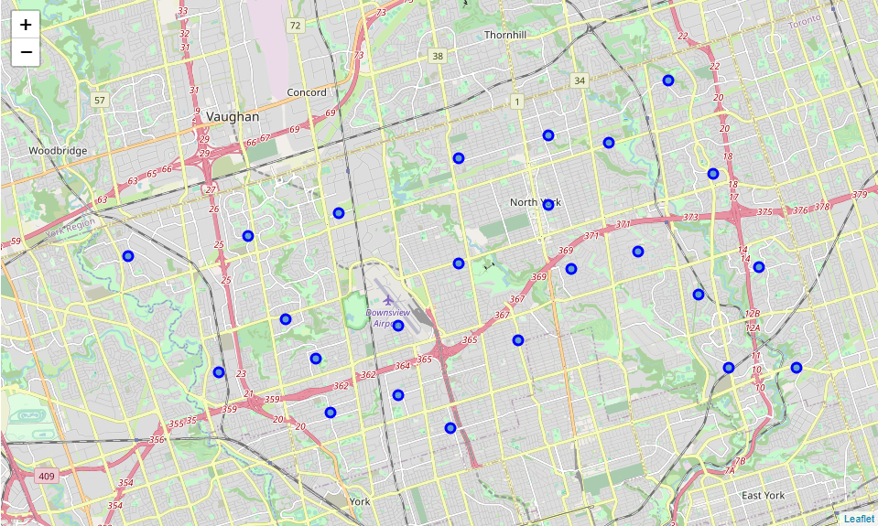
North York Toronto

Slide 5
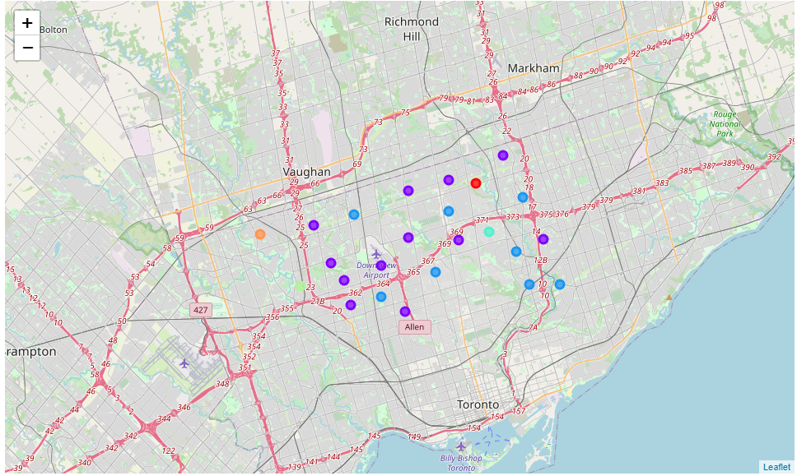
Cluster North York Neighborhoods based on common venue types

Slide 6
Cluster 1
Cluster 1 contains only Bayview Village neighborhood. There are a lot of Gas stations, banks & grocery stores in the area. Cafes are the 6th most common venue. Based on our desired parameters, Bayview Village is not a desired area to open a new office for our company or as a place of residence.

Slide 7
Cluster 2
Cluster 2 contains a bigger number of neighborhoods. We can see that we have either parks or cafes in top common venue types and there are a lot of restaurants. Based on our desired parameters, these neighborhoods are worth consideration as a desired area to open a new office for our company and as a place of residence.

Slide 8
Cluster 3
Cluster 3 contains also a big number of neighborhoods. We can see that Coffee shops are the most common venue by far. There are a lot of restaurants but not many parks. Based on our desired parameters, these neighborhoods are worth consideration as a desired area to open a new office for our company and as a place of residence.

Slide 9
Cluster 4
Cluster 4 contains only 2 neighborhoods (York Mills & Silver Hills). We can see that Parks are the most common venue. There are some restaurants nearby but not Coffee shops. Based on our desired parameters, we cannot consider these neighborhoods for opening a new office, but we can consider them as a place of residence.

Slide 10
Cluster 5
Cluster 5 contains only Humberlea, Emery neighborhood. We can see that Discount Stores and Convenience Stores are the most common venue. There are Parks nearby but not Coffee shops. Based on our desired parameters, we cannot consider these neighborhoods for opening a new office, but we can consider them as a place of residence.

Slide 11
Cluster 6
Cluster 6 contains only Humber Summit neighborhood. We can see that Electronic Stores and Banks are the most common venue. There are Parks nearby and some Restaurants but not Coffee shops. Based on our desired parameters, we cannot consider these neighborhoods for opening a new office, but we can consider them as a place of residence.

Slide 12
Final Results
Based on our overall results we will drop Clusters 1, 4, 5 & 6 with Neighborhoods as potential candidates for a new office location or a place of residence. Cluster 2 and Cluster 3 Neighborhoods seem more promising.
By examining more closely our data and after more investigation we decide not to consider Downsview as a candidate especially as a residential area because of the close proximity to the airport.
It seems that our best bets are North Park, Maple Leaf Park & Upwood Park from Cluster 2 and all Neighborhoods of Cluster 3.

Slide 13
Recommendations
Our efforts would be more precise if we could take under consideration:
General competition in the area
Coffee shop types in order to determine the possible new equipment or maintenance budget
Import other parameters for our residential candidates such as crime rates, median income etc.

